Slide 1

Green Pace
Security Policy Presentation
Developer: Michael Martin
[Complete this template by replacing the bracketed text with the relevant information.]

Slide 2

OVERVIEW: DEFENSE IN DEPTH
The security policy will implement measures into each step of the DevOps environment to ensure a secure environment is implemented (DevOpsSec) and secure code is used at all steps of the process.

Slide 3
THREATS MATRIX
Likely STR02-C ERR55-CPP INT32-C | Priority INT31-C MEM35-C DCL30-C EXP50-CPP
Low priority N/A | Unlikely STD-001-CPP INT00-C FIO47-C DCL03-C
The table to the right shows the likelihood of the provided threats. Priority and Likely are the vulnerabilities considered high risk and should be resolved immediately.

Slide 4
10 PRINCIPLES
Validate Input Data – Validate all data coming from external or untrusted sources. This will remove the majority of vulnerabilities.
INT00-C, INT 31-C, STR02-C
Heed Compiler Warnings - While compiling code pay attention to the highest warning level and be sure to modify the code to remove these warning.
Architect and Design for Security Policies – Create and use a software design document to ensure the implementation of security policies. This will also help enforce the use and need of said policies.
Keep It Simple - Keep the design of your system simple, as the more complex the system becomes the more likely that bugs and vulnerabilities will be introduced. It also becomes much harder to detect and fix bugs and vulnerabilities that do appear in the system.
Default Denny - Create the access to the system based on roles and permissions rather than exclusion lists.
Adhere to the Principle of Least Privilege - Access should be given in a way that the requester only gets the amount of access necessary to complete the task. If elevated permission is necessary, it should be removed immediately after the completion of the task.
Sanitize Data Sent to Other Systems - Remove special characters or known commands/actions when transferring data between systems. This can prevent incidents such as injection attacks.
STR02-C
Practice Defense in Depth - Be sure to have multiple layers of security in case one layer turns out inadequate at protecting a specific attack. Evaluate environment to decide on how many layers are necessary.
Use Effective Quality Assurance - By using external audits, pen testing, etc, it can lead to more secure code and systems and overall prevent intrusions and vulnerabilities.

Slide 5
CODING STANDARDS
The table to the right includes critical coding standards. The standard are organized by Level of severity. All L1 and L2 should be implemented immediately and not ignored if found.
Rule | Severity | Likelihood | Remediation Cost | Priority | Level
STR02-C | High | Likely | Medium | P18 | L1
STD-001-CPP | High | Unlikely | Medium | High | L2
INT00-C | High | Unlikely | High | P3 | L2
INT31-C | High | Probable | High | P6 | L2
FIO47-C | High | Unlikely | Medium | P6 | L2
MEM35-C | High | Probable | High | P6 | L2
DCL03-C | Low | Unlikely | High | P1 | L3
ERR55-CPP | Low | Likely | Low | P9 | L2
DCL30-C | High | Probable | High | P6 | L2
INT32-C | High | Likely | High | P9 | L2
EXP50-CPP | Medium | Probable | Medium | P8 | L2

Slide 6
ENCRYPTION POLICIES
Below is the encryption policy and how each type of encryption is defined.
Encryption in rest | This type of encryption provides protection for stored data, irrelevant of the device it’s on. This helps prevent unwanted data access, whether it be physically attempting to access the data or remotely. A common encryption algorithm used is AES 256
Encryption at flight | This encryption protects data as it moves through a network, such as a WAN or larger LANs. Typically, a key that is unique is shared between the two devices and is decrypted once received. This is useful for several reasons, such as a bank send data to a brand, or a hospital transferring data with a patient.
Encryption in use | This type of encryption is typically data in use by one or more applications. This includes data being read, written, or executed. Generally, this form of encryption is difficult to implement at a software level and should be implemented via hardware. Manufacturers such as Intel and AMD include such features directly into their processors.

Slide 7
TRIPLE-A POLICIES
The table below includes definitions of each policy
Authentication | Checks who are attempting to access the resource by requiring a username and password, SSO systems, biometrics, digital certificates, and public key infrastructure. Each user will have a unique ID, with specific roles and access assigned. This prevents unwanted access or malicious actors from access systems and using resources that shouldn’t. Such as IoT devices or servers.
Authorization | Checks to see what resources the user is authorized to use and permits that access. This can be decided by a role, rule, or policy and can be applied per user, group, or physical location. This ensures that an authorized user can only see what they should. Such as a receptionist should not be able to access ESXI.
Accounting | Records logs and watches the network to see what users consume or do on their account. Stuff such as network logs, application usage, session duration, and even the amount of data used can fall into this category. This can ensure that if a user tries to copy a file without permission it is recorded into the logs and can prevent a data leak.

Slide 8
Unit Testing
Unit Testing Buffer Overflow – INT32-C

Slide 9
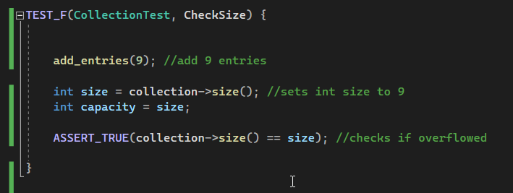
Check size

Slide 10
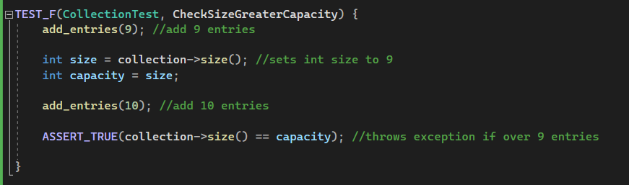
Check capacity

Slide 11
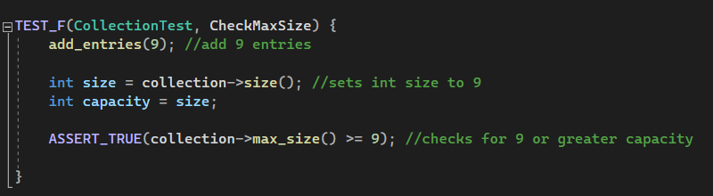
Check max size

Slide 12
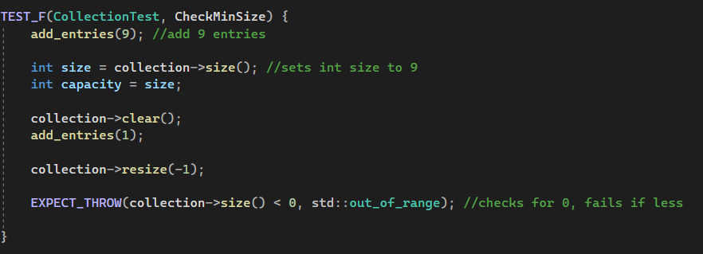
Check minimum size

Slide 13

AUTOMATION SUMMARY

Slide 14
TOOLS
The DevSecOps Pipeline seamlessly integrates application and infrastructure security into the existing DevOps Pipeline
To change a DevOps environment into a DevSecOps environment you must adapt a security first environment. Starting with the “Pre-production”phase of the environment; therat modeling, security tool training, and metrics/threat modeling are added to the “Access and Plan” step. Next, within the “Design” and “Build” steps Security Plug-Ins are added to the IDE. Moving to Verify and Test, adding application testing and vulnerability scans will assist with the DevSecOps transition. Within the “Production” phase automated tests and monitoring are enabled. Starting with “Transition and health check” step, adding Signature Verity, Integrity Checks, and Defense In-Depth Measures will ensure the steps meets DevSecOps requirements. With the step “Monitor and detect” using Network Monitoring and Penetration Testing would secure it. “Respond” should implement the use of RASPH/WAF Shielding and Obfuscation. Finally, “Maintain and stabilize” should use Dev Consumables and Vulnerability Analysis.

Slide 15
RISKS AND BENEFITS
To summarize, the benefits outweigh the risks no matter the way you look at it. We live in a word where everything in interconnected, whether is be a LAN or a WAN, the device likely has a network connection. Knowing this, having secure code is required to have a stable and secure system. To write secure code, the development environment must also be in place to support and enforce the use of secure code. This policy was written in a way that will enforce the use and implementation of secure code, while attempting to keep it somewhat convenient for the developer and engineer.
Example: Equifax did not adapt their environment to keep with current threat vectors, resulting in a massive data breach of user's personal information.

Slide 16
RECOMMENDATIONS
Gap: A potential gap in the security policy is a new untrained user being put into the environment. If the user does not have the proper training, they may not know how to apply the environments policies in a correct manner.
Gap: A breached computer. This policy does not cover antivirus, MDM, nor network security.
Recommendation: Work with IT on implementing device security
Recommendation: Conduct user training on day 1 of their employment.

Slide 17
CONCLUSIONS
Ensure that a review of this and other company security policies are reviewed once to twice a year. This will keep the policy up-to-date and every updating to ensure all new threats are identified.

Slide 18
REFERENCES
DEVSECOPS tools: 9 ways to integrate security into the SDLC. Aqua. (2022, November 28). Retrieved December 18, 2022, from https://www.aquasec.com/cloud-native-academy/devsecops/devsecops-tools/
By: IBM Cloud Education. (202AD, July 30). What is DevSecOps? IBM. Retrieved December 18, 2022, from https://www.ibm.com/cloud/learn/devsecops

